Slide 1
WEB FRAMEWORKS – SPECIAL TOPIC
VIDHU ROJIT

Slide 2
SYLLABUS
Introduction: What are frameworks? Frameworks vs Libraries , Classification of Frameworks, Selecting Frameworks, Client-Server Architecture, HTTP, MVC Pattern
Django I: Basics , URL mappings, Templates and Static Media
Django II: Models & Databases, Forms, User Authentication
React.js: Introduction, Building a React App, Components, State, Accessing DOM Elements, Events, Redux
Misc. Frameworks: Interaction between frameworks, Connecting React & Django

Slide 3
REFERENCE Material
Learning React, Kirupa Chinnathambi
Django Girls

Slide 4
NOTES & CONACT
Contact Info
vidhu.tjit@gmail.com
All notes and class related info will be available at
webfw2020.school.blog

Slide 5
Evaluation policy
ISA (Will be reduced to 20 marks)
ISA 1 : Hands on exercise on Django (20 Marks)
2 Quizzes (10 marks each)
Assignment: Using a new framework. (10 marks)
ESA
Pen & Paper - 30 Marks (Reduced to 15 marks)
Project – 15 Marks

Slide 6
introduction

Slide 7
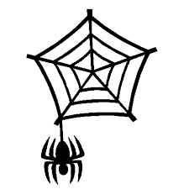
What is the Web?
A complex system of interconnected elements

Slide 8

Let’s try again!!! – What is Web?
The World Wide Web, also known as the WWW and the Web, is an information space where documents and other web resources are identified by Uniform Resource Locators (URLs), interlinked by hypertext links, and accessible via the Internet.

Slide 9
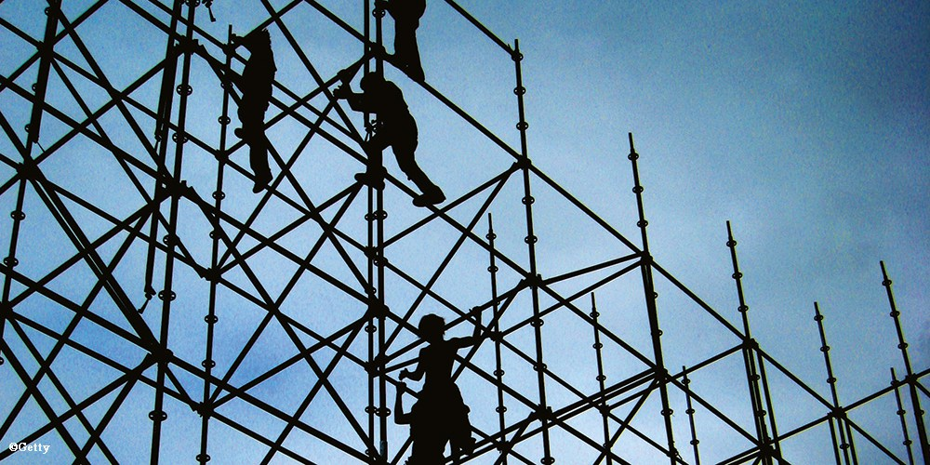
What is a framework?
The structure of a particular system

Slide 10
What is this COURSE ABOUT ?
Web Framework = Web Application Framework

Slide 11
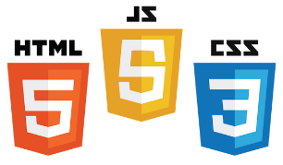
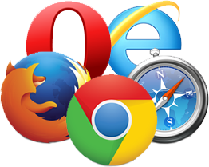
Core Components of Web Applications
Server
Client
API
Front End
Database
Browser
Internet
Logic
JSON
UI (Front End (DOM, Framework))
Request Layer (Web API)
Back End (Database, Logic)
Media Cache
Notes:
Break down into front end and back end

Slide 12
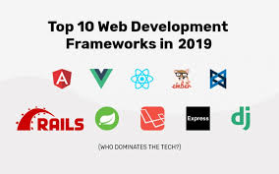
Web Frameworks
A web framework also known as web application framework is a software framework that is designed to support the development of web applications including web services, webresources and web APIs. Web frameworks aim to alleviate the overhead associated with common activities performed in web development

Slide 13

But I already know HTML,CSS and JavaScript ???

Slide 14
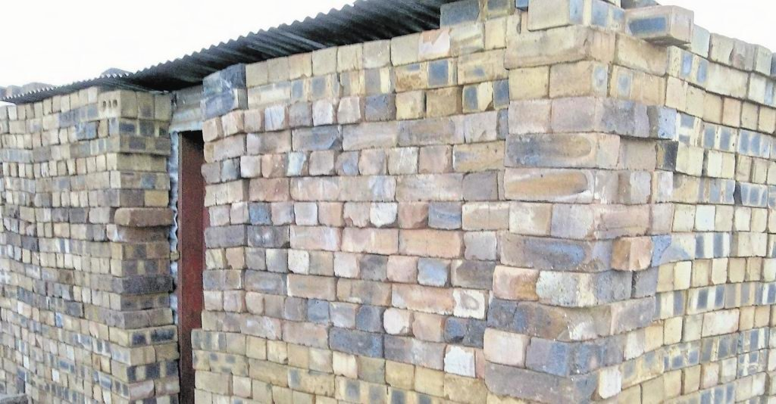
The website you created….

Slide 15

A website made using frameworks

Slide 16
We know bootstrap and jQuery!!!
jQuery is a JavaScript library designed to simplify HTML DOM tree traversal and manipulation, as well as event handling, CSS animation, and Ajax
Bootstrap is a free and open-source front-end framework for developing websites and web applications. It contains HTML and CSS-based design templates

Slide 17
Hmmm…..SO WHAT ARE FRAMEWORKS???
Again, a framework (a bit oversimplified) is an extendable set of objects for related functions.
“Signature” of a framework is that it provides an implementation for the core and unvarying functions, and includes a mechanism to allow a developer to plug in the various functions, or to extend the functions.

Slide 18
Let’s go back in time….

Slide 19
In the beginning…
HTML Pages
Web developers wrote every page “by hand”
Updating a web site meant editing HTML
“redesign” involved redoing every page
Solution not scalable

Slide 20
Along came CGI
Common Gateway Interface
A standard protocol for web servers to execute programs that execute like console applications running on a server that generates web pages dynamically.
Marked the beginning of server side technologies
Allowed pages to be generated dynamically
High learning curve
Code reuse was difficult

Slide 21
Our good friend PHP
Shallow learning curve
Spaghetti code – HTML ,SQL
No security mechanism

Slide 22
RIA
Rich Internet Applications
Desktop like web applications

Slide 23
CMS
Aim to manage work-flows and contents in a collaborative environment
Designed to simplify the publication of contents to web sites and mobile devices

Slide 24
Web Frameworks
Aim to alleviate the overhead associated with common Web development ○ Databases, templates, sessions, …
Designed to support the development of dynamic websites, web applications and web services

Slide 25
SELECTING FRAMEWORKS
CRITERIA FOR SELECTING FRAMEWORKS

Slide 26
Productivity
Pace of development
Ease of maintaining and enhancing code.
Does the framework advocate "Best Development Practices"?
Opinionated vs Non-opinionated
Inbuilt Testing Frameworks?

Slide 27
Learning Curve
Familiarity with underlying language
Documentation
APIs
Size of the community working with it.

Slide 28
Framework purpose
Why the framework came into place?
Django was developed for Newspaper site and is especially suited for blog-sites.
Flask is ideal for embedded architectures

Slide 29
OTHER CRITERION
Performance: Speed of the framework.
Scalability: Vertical vs Horizontal Scaling.
Security Features - What inbuilt features does the Framework provide?
Other important features - Emails, user management, caching, Web Services etc

Slide 30
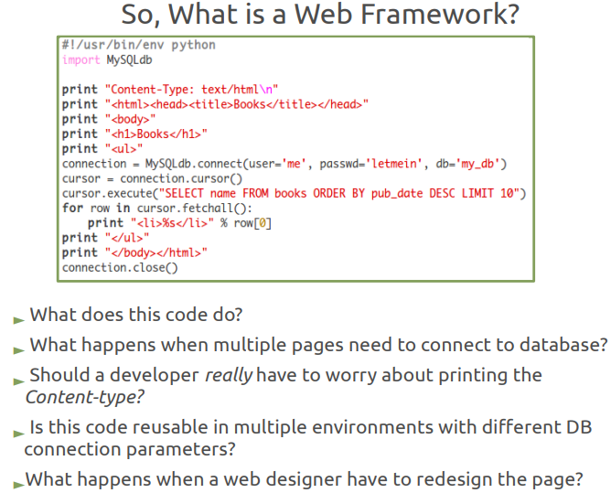

Slide 31
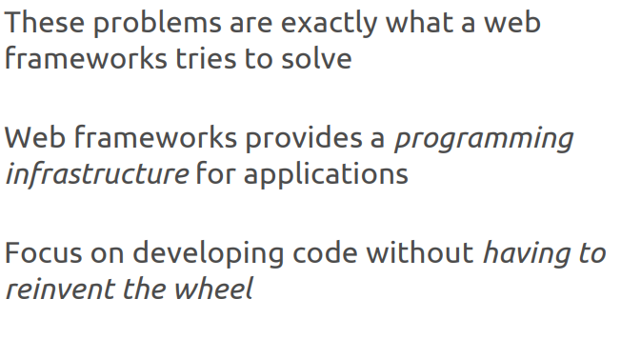

Slide 32
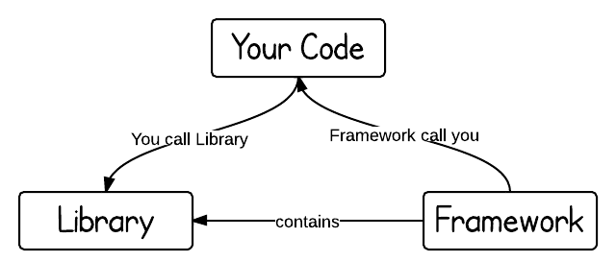
FRAMEWORK vs LIBRARY

Slide 33
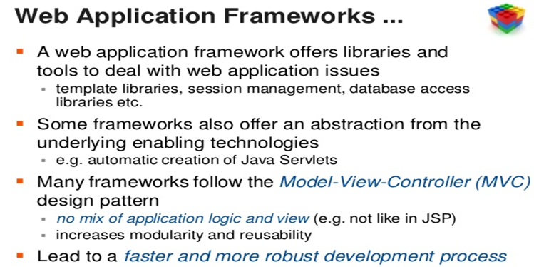

Slide 34
MVC – An Architectural Paradigm

Slide 35
What is the MVC Pattern?
Model: Structures your data in a reliable form and prepares it based on controller’s instructions
View: Displays data to user in easy-to-understand format, based on the user’s actions
Controller: Takes in user commands, sends commands to the model for data updates, sends instructions to view to update interface.

Slide 36
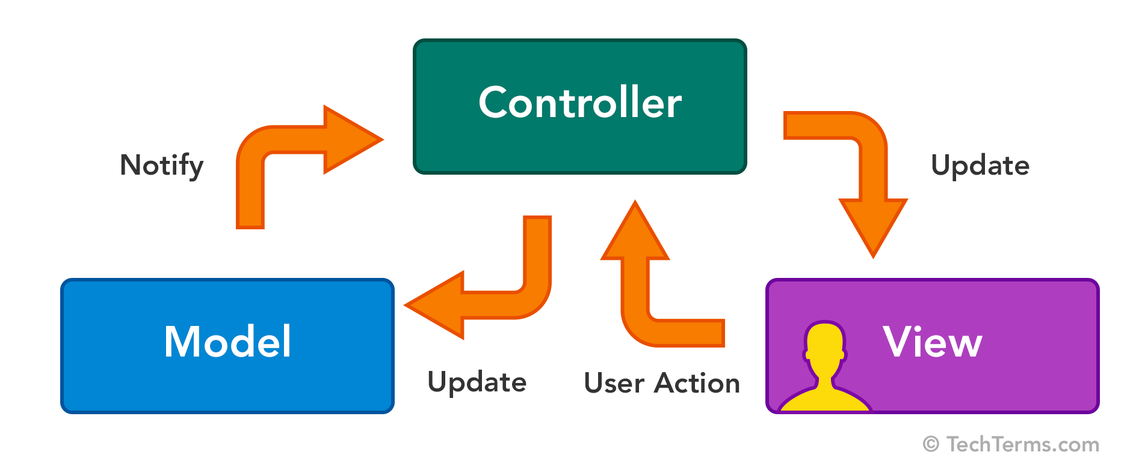
MVC – In pictures

Slide 37
The user makes a request along a route, let’s say /home.
The controller receives this request and gives a specific set of orders that are related to that route. These instructions could either be for the view to update or serve a certain page, or for the model to perform specific logic. Let’s assume this request has some logic associated with it.
The model carries out the logic, pulls from a database and sends back a consistent response based on the controller’s instructions.
The controller then passes this data to the view to update the user interface.

Slide 38
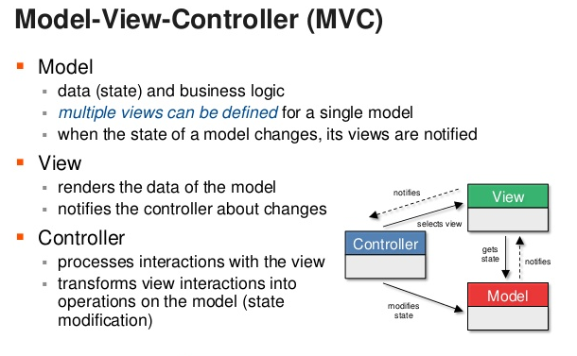

Slide 39
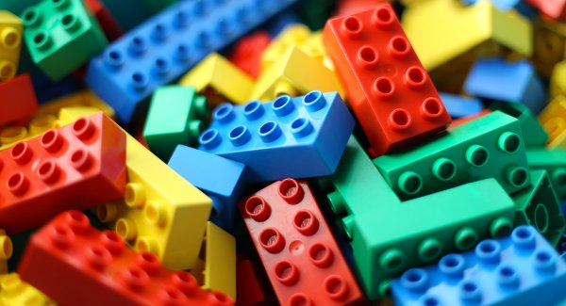
Explaining MVC – Not a task for the faint hearted
https://realpython.com/the-model-view-controller-mvc-paradigm-summarized-with-legos/

Slide 40
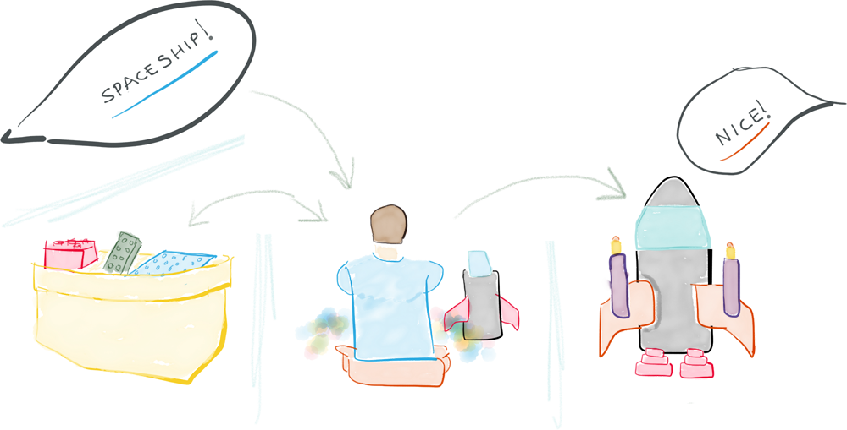

Slide 41
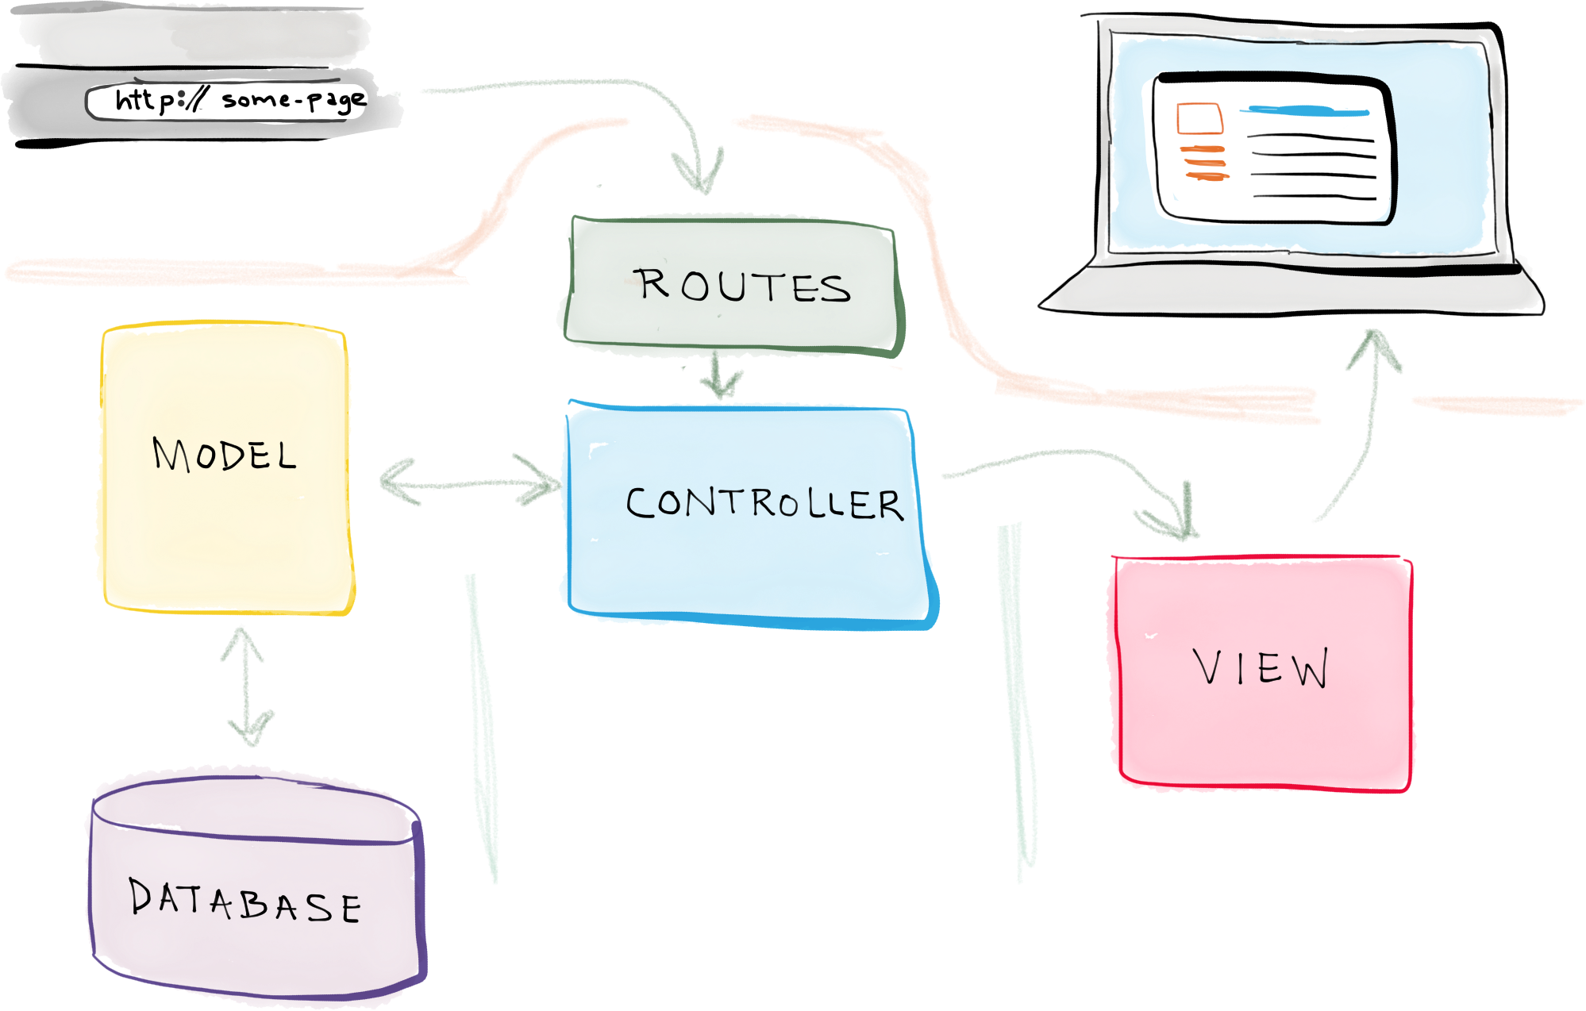

Slide 42
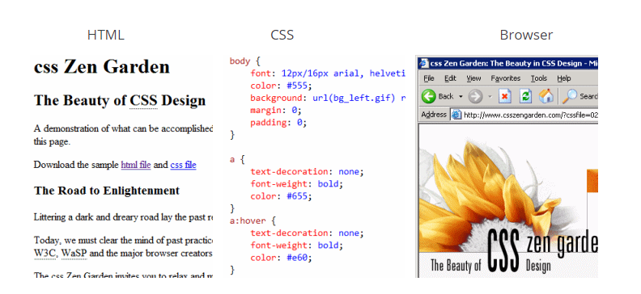
Your Turn…
https://blog.codinghorror.com/understanding-model-view-controller/

Slide 43
Advantages of MVC
1. Separation of concerns: a. The separation the three components, allows the re-use of the business logic across applications. b. Multiple User Interfaces can be developed without concerning the codebase. 2. Developer specialization and focus: a. The developers of UI can focus exclusively on the UI screens without bogged down with business logic. b. The developer of Model / business can focus exclusively on the business logic implementations, modifications, updations without concerning the look and feel and it has nothing to with business logic. 3. Parallel development by separate teams: a. Business logic developers can build the classes, while the UI developers can involve in designing UI screens simultaneously, resulting the interdependency issues and time conservation. b. UI updations can be made without slowing down the business logic process. c. Business logic rules changes are very less that needs the revision / updations of the UI.

Slide 44
Disadvantages of MVC
So if MVC is the greatest thing since sliced bread then why isn’t everyone doing it all the time? It’s a mistake to think MVC is a magic bullet that will cure all your software problems.
Complexity - MVC adds a layer of complexity to any project. This is a cost that’s acceptable with a huge payoff and that usually comes from large projects that would be complex anyway. But a small app or widget is better off without such complexity. Sometimes MVC just adds more work to a task that would otherwise be simple.
Can affect performance - If you have a simple widget that uses 20 lines of code and a simple task it could very well be slower when done in an MVC environment. Again it comes down to cost vs benefit, and MVC doesn’t always win.
You may be using non MVC code in your project - You could be stuck with code that is already built with model and view functionality tightly integrated. Trying to mix and match in an MVC model can cause more problems than it solves.
Additional Resource Usage - MVC frameworks are avoided in low resource environments such as embedded software and programs designed to run very lean. When you’re building a web app on a big server the fractional increase in memory usage is well worth the benefits but if you’re counting bytes or squeezing something onto a chip it’s best to avoid them.
https://www.jeremymorgan.com/blog/programming/what-is-mvc/

Slide 45
ORM

Slide 46
OBJECT RELATIONAL MAPPING
a) What is an Object Model?
b) What is a Relational Model?
c) How to combine?
d) What is Transparent Persistence (TP)?
TP vs Call Interfaces
(A call interface is typically an adapter layer that converts
generic db calls to vendor-specific calls. Ex: the JDBC drivers)
e) How ORM works. Advantages?
- Faster Applications (performance)
- Abstraction between diff database engines

